Slide 1

🔒
Smart Door Lock System
Presentation by Matthew Nathan Wijaya
SMART DOOR LOCK SYSTEM | IOT ARCHITECTURE

Slide 2


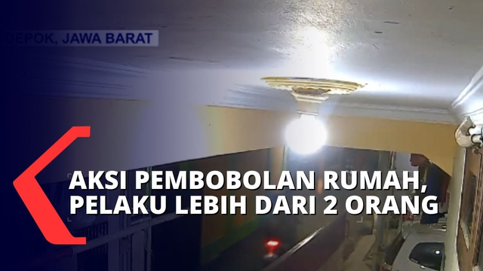
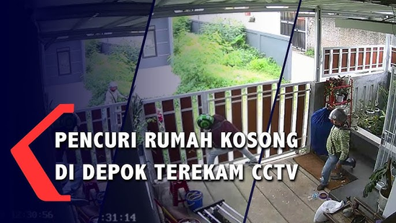


Background
In today's world, home security has become a paramount concern for individuals. The recent surge in home burglary cases has instilled fear and anxiety among the public. While the implementation of CCTV cameras and surveillance systems has played a role in apprehending perpetrators, their limited accessibility and installation challenges hinder the realization of comprehensive security measures.
This innovative system seamlessly integrates a smart door lock with a built-in camera, empowering users to control access and monitor their security in real-time via their mobile devices. This groundbreaking technology elevates home security to new heights while enhancing user convenience and accessibility.
SMART DOOR LOCK SYSTEM | IOT ARCHITECTURE

Slide 3
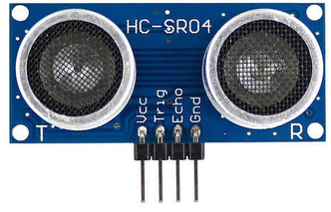
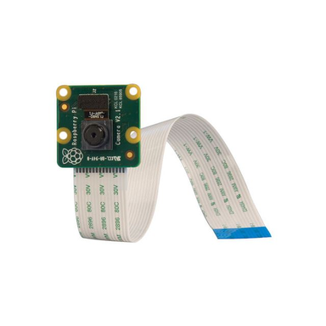
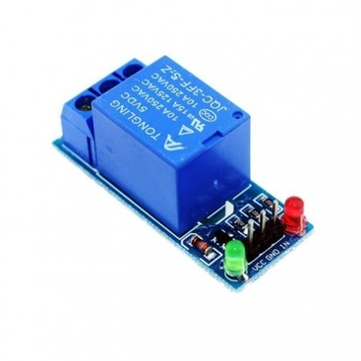
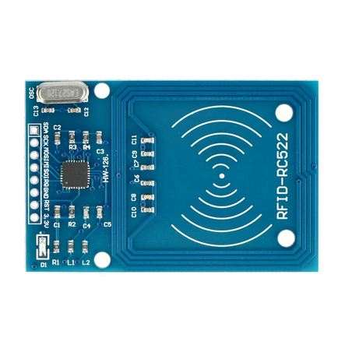
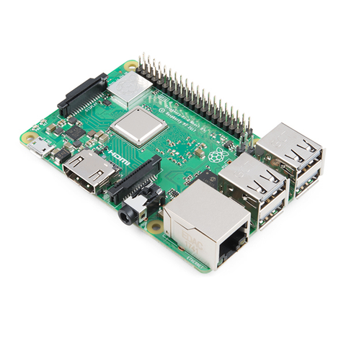
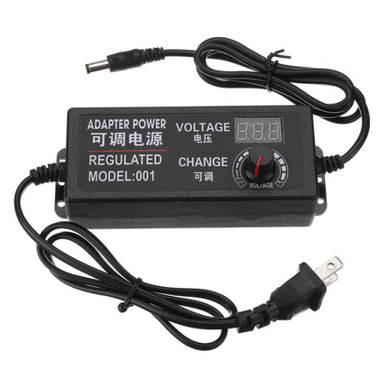
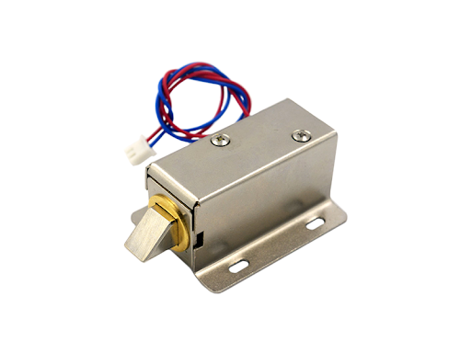
Components
II
Pi Camera
Relay
Ultrasonic Sensor
RFID
Raspberry Pi
Adjustable Power Adapter
Solenoid Door Lock

Slide 4


Smart Door Lock System Diagram
Raspberry Pi
Mobile Application
Telegram
RFID
Relay
Solenoid Door Lock
Konsep Proyek
Ultrasonic Sensor
Sistem ini menggunakan tiga sensor yaitu ultrasonik, kamera, dan RFID, serta menggunakan machine learning untuk menentukan output, apakah pintu akan terbuka atau akan mengirimkan notifikasi kepada pengguna. Sensor ultrasonik digunakan untuk mengukur jarak, kamera untuk mengenali wajah, dan RFID untuk identifikasi tambahan. Dengan kombinasi ketiga sensor ini, serta algoritma machine learning yang cerdas, sistem ini dapat secara efektif menentukan tindakan yang tepat, baik membuka pintu secara otomatis atau mengirimkan notifikasi kepada pengguna jika ada aktivitas mencurigakan.
SMART DOOR LOCK SYSTEM | IOT ARCHITECTURE
Pi Camera
Adjustable Power Adapter
Data Flow
Energy Flow
Information Flow

Slide 5

Main Feature
IV
Access History
Dual Authentication
Real-Time Monitoring
Notifications and Alerts

Slide 6
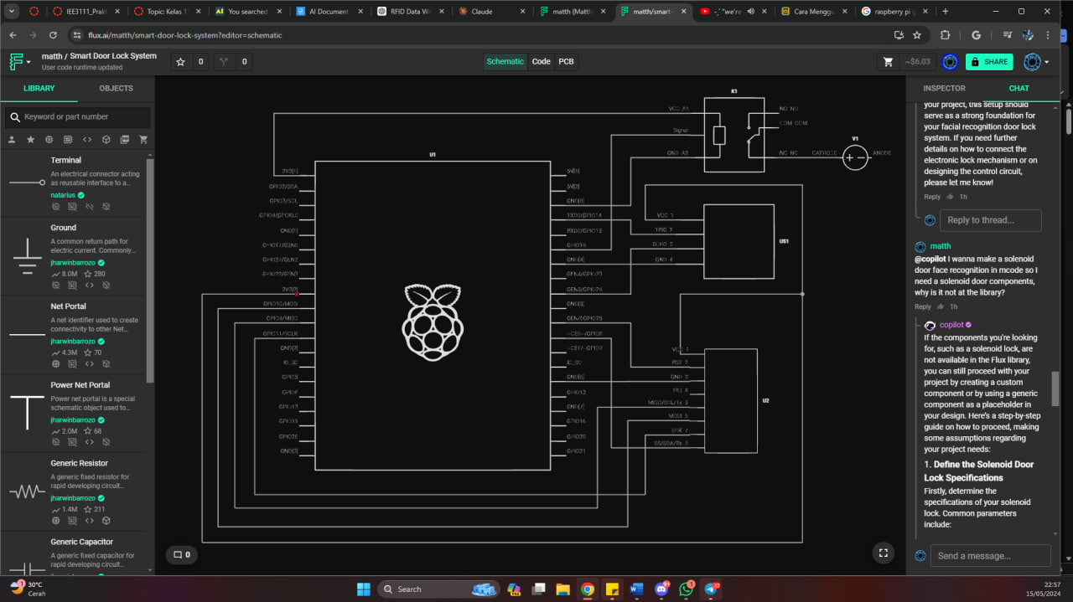
V
Schematic
SMART DOOR LOCK SYSTEM | IOT ARCHITECTURE

Slide 7
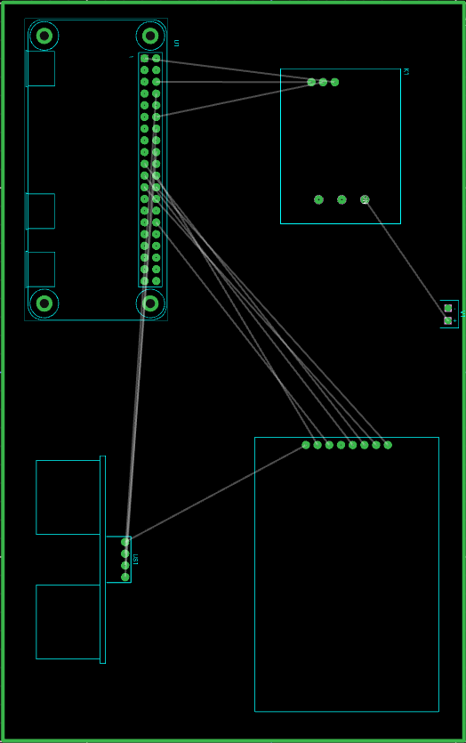
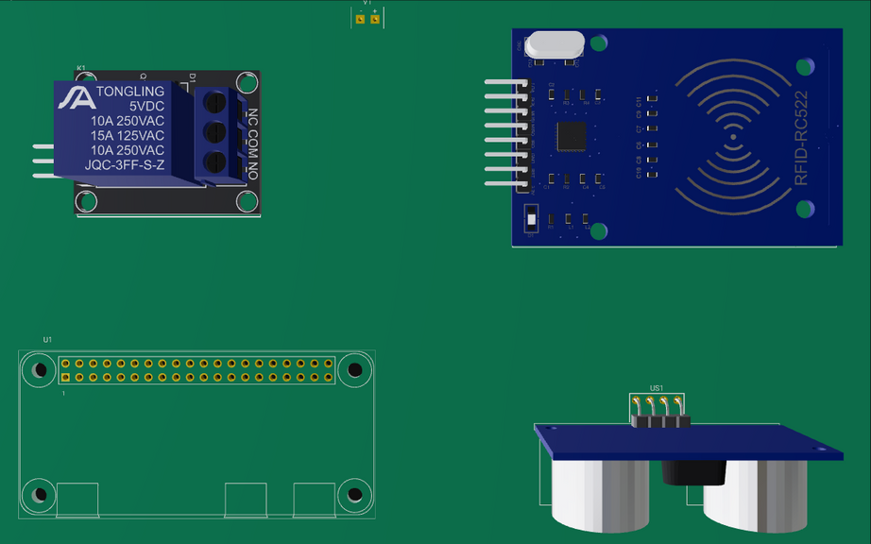
VI
PCB Visualization
SMART DOOR LOCK SYSTEM | IOT ARCHITECTURE

Slide 8
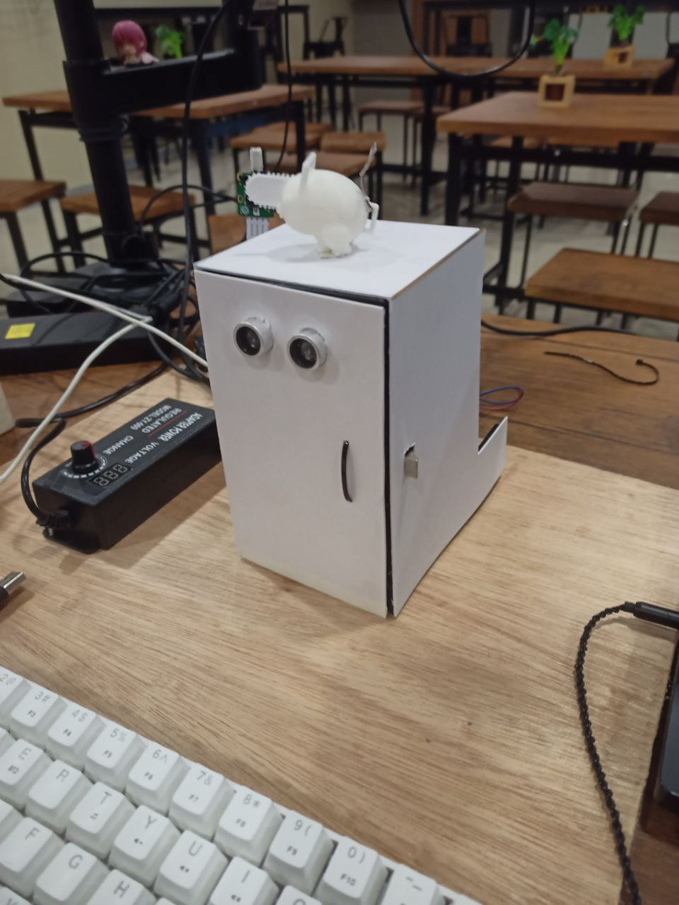
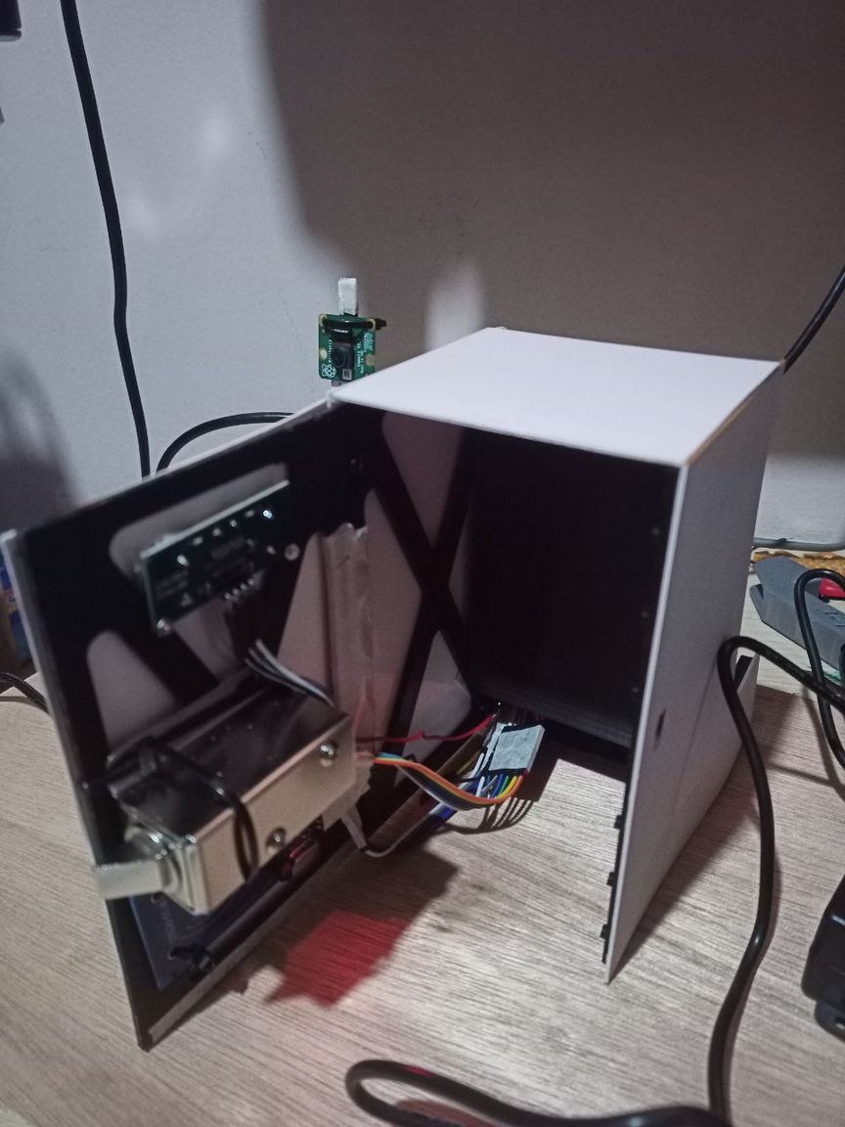
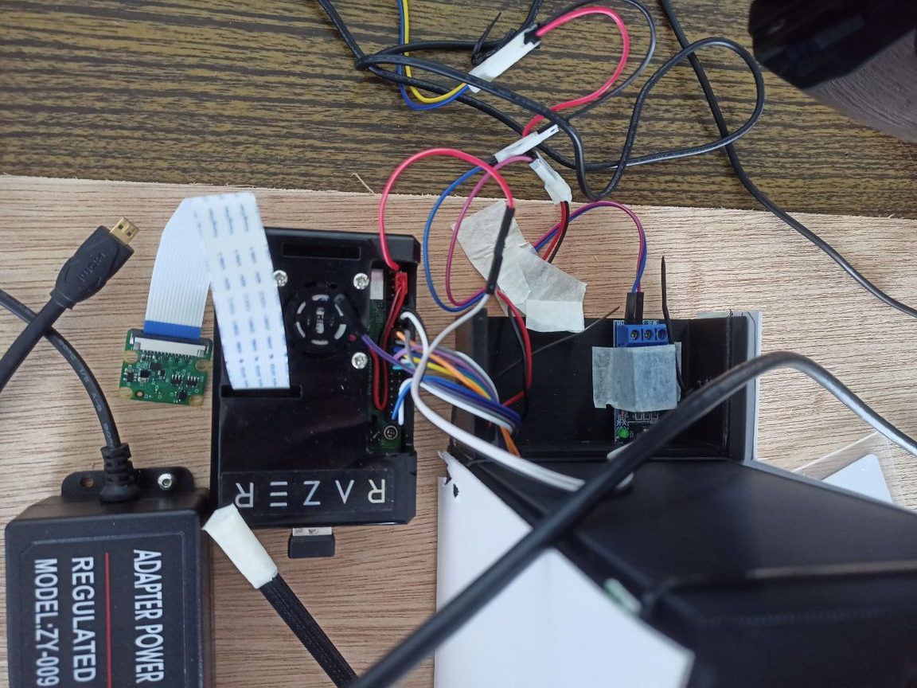
Product Prototype
Pi Camera
Ultrasonic Sensor
Relay
Solenoid Door Lock
Ultrasonic Sensor
Raspberry Pi
Adjustable Power Adapter
RFID
Adjustable Power Adapter

Slide 9
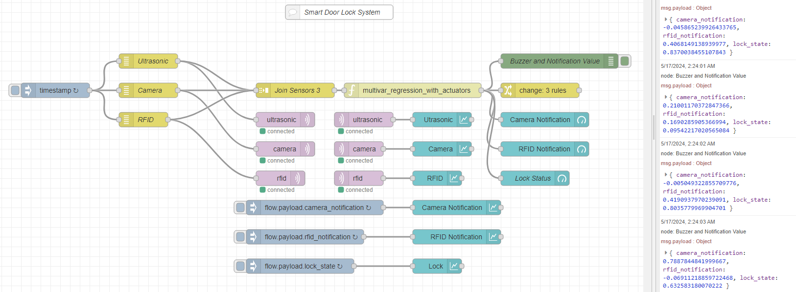
Node-red Flow
SMART DOOR LOCK SYSTEM | IOT ARCHITECTURE

Slide 10
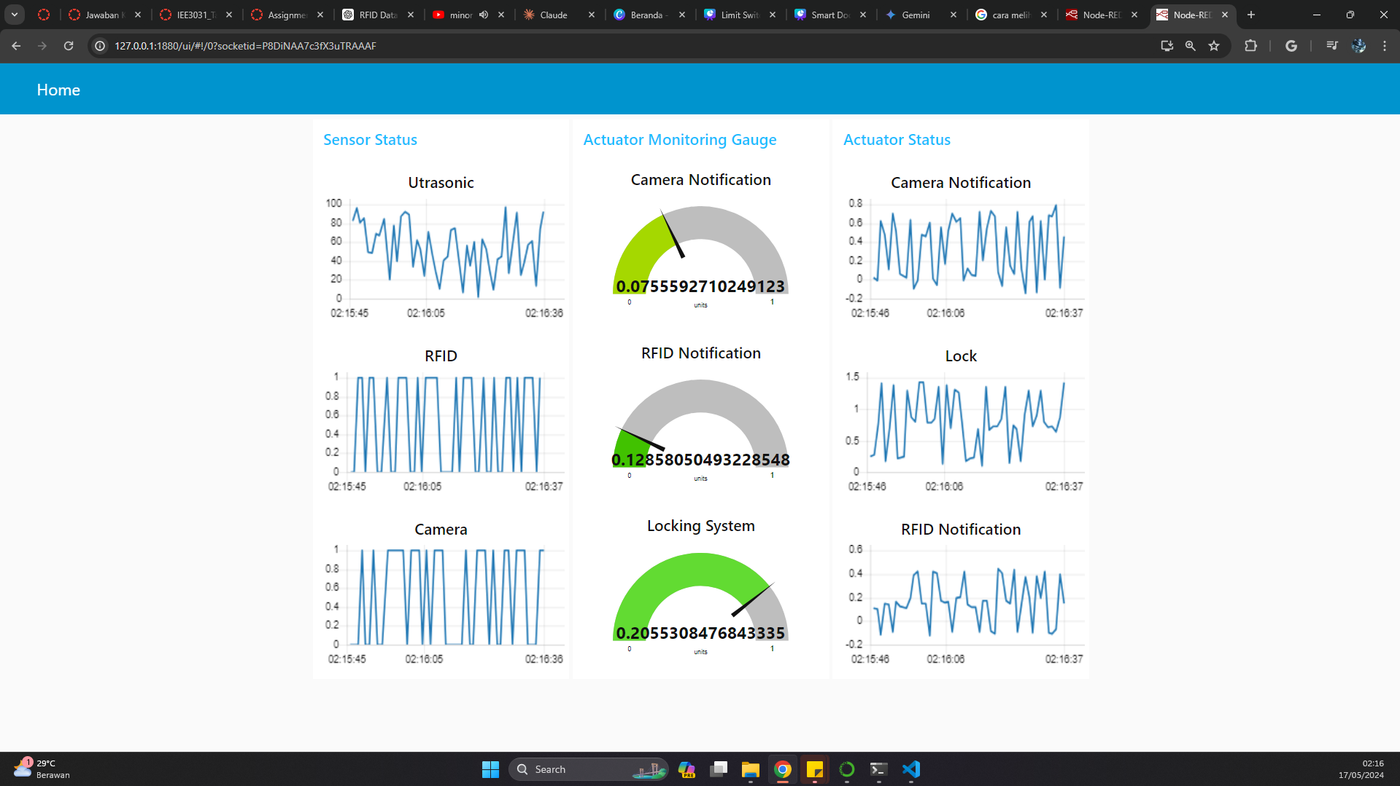
IX
Node-red Dashboard
SMART DOOR LOCK SYSTEM | IOT ARCHITECTURE

Slide 11




THANK YOU

